Slide 1
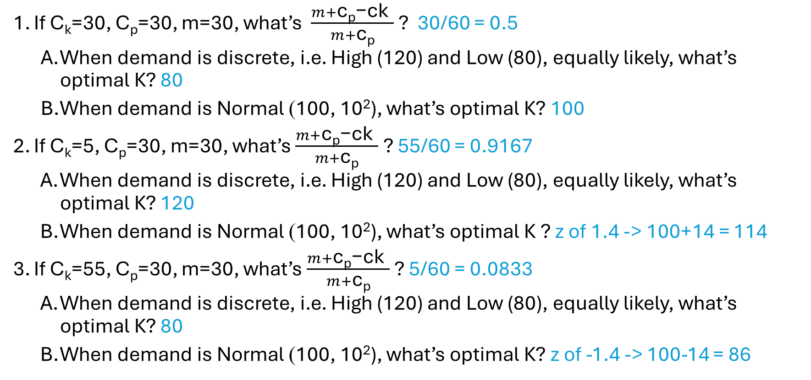
In-class Exercises on Optimal Capacity Size
If C_{k}=30, C_{p}=30, m=30, what’s $\frac{m+\text{c}\text{p}\text{−}\text{ck} }{m+\text{c}\text{p}}$ ? 30/60 = 0.5
When demand is discrete, i.e. High (120) and Low (80), equally likely, what’s optimal K? 80
When demand is Normal (100, 10²), what’s optimal K? 100
If C_{k}=5, C_{p}=30, m=30, what’s $\frac{m+\text{c}\text{p}\text{−}\text{ck} }{m+\text{c}\text{p}}$ ? 55/60 = 0.9167
When demand is discrete, i.e. High (120) and Low (80), equally likely, what’s optimal K? 120
When demand is Normal (100, 10²), what’s optimal K ? z of 1.4 -> 100+14 = 114
If C_{k}=55, C_{p}=30, m=30, what’s $\frac{m+\text{c}\text{p}\text{−}\text{ck} }{m+\text{c}\text{p}}$ ? 5/60 = 0.0833
When demand is discrete, i.e. High (120) and Low (80), equally likely, what’s optimal K? 80
When demand is Normal (100, 10²), what’s optimal K? z of -1.4 -> 100-14 = 86

